Slide 1

Capstone Project: Customer Segmentation
- Mohd Arham Islam

Slide 2
Business Problem
The project aims to identify major customer segments for a UK-based online retail company that sells unique all-occasion gifts.
The dataset contains all the transactions that occurred between 1st December 2010 and 9th December 2011.
The project will use data analysis techniques and segmentation methodologies to gain insights into the customer segments and their characteristics.
This will enable the company to customize its marketing and operational strategies to meet the needs and expectations of each segment, resulting in higher customer satisfaction and loyalty, and ultimately, greater business growth and profitability.

Slide 3
Understanding the dataset
The dataset contains the following fields:
InvoiceNo: This field represents the invoice number associated with each transaction. It serves as a unique identifier for each purchase.
StockCode: The StockCode field corresponds to the stock name code of the product being purchased. It helps identify the specific item in the company's inventory.
Description: This field provides a description of the product being sold. It offers additional information about the nature, features, or characteristics of the item.
Quantity: The Quantity field indicates the quantity of the product bought in each transaction. It represents the number of units purchased.
InvoiceDate: This field denotes the date of the transaction. It captures the exact date and time when the purchase was made.
UnitPrice: The UnitPrice field represents the price per unit of the product being sold. It indicates the cost of a single unit of the item.
CustomerID: The CustomerID field contains a unique identifier for each customer. It helps track individual customer behavior and preferences across multiple transactions.
Country: The Country field specifies the location or country where the transaction took place. It provides information about the geographical distribution of the company's customer base.

Slide 4
Agenda
Explore the customer dataset and extract valuable insights about their behavior and preferences
Develop and evaluate multiple machine learning models to segment the customers into distinct groups based on their features
Use appropriate metrics to measure the performance of the models and choose the most suitable model for the given dataset
Identify the limitations of the chosen model and propose possible enhancements to increase its accuracy in predicting customer behavior
Summarize the findings and provide recommendations based on the analysis to help the company optimize their strategies

Slide 5
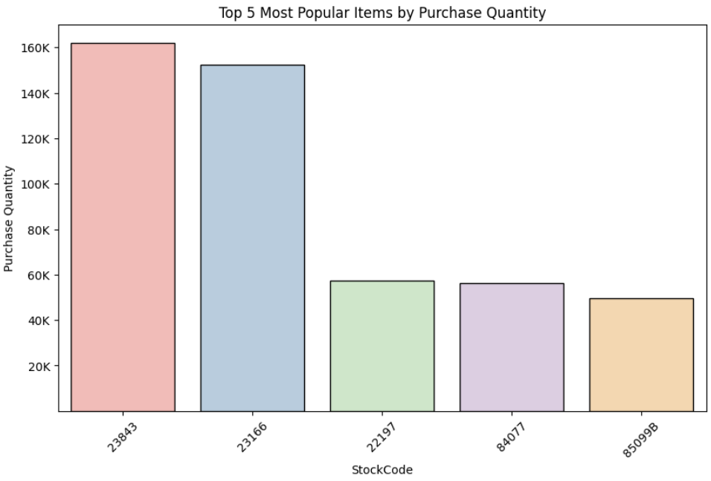
Top 5 Most Popular Items
The chart displays the purchase quantity of different items by their Stock Code.
The item with Stock Code 23843 is the most sought-after product.
The item with Stock Code 23166 is the next most preferred product.
There is a significant gap between the first two items and the rest, with the former having around 150K purchase quantity and the latter having around 60K. This indicates a huge difference in customer demand for these products.
By analyzing the most popular items based on their purchase quantity, the business can better meet customer expectations and manage inventory efficiently.

Slide 6
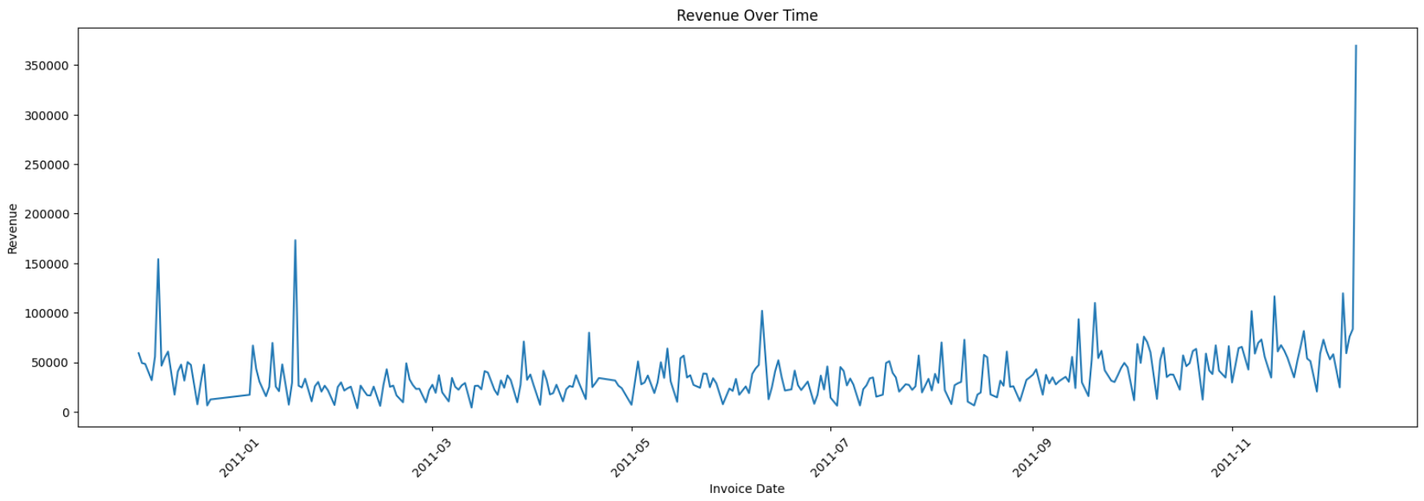
Revenue Over Time
The line chart shows seasonal patterns in the revenue over time.
Regular peaks in the chart indicate higher revenue periods.
Businesses can leverage these patterns to optimize their operations and marketing strategies.
Some peaks are higher than others, implying some factors lead to significantly higher revenue.
Businesses can analyze these factors, such as promotions, events, or products, to identify the best practices and opportunities that can boost their revenue and growth.

Slide 7
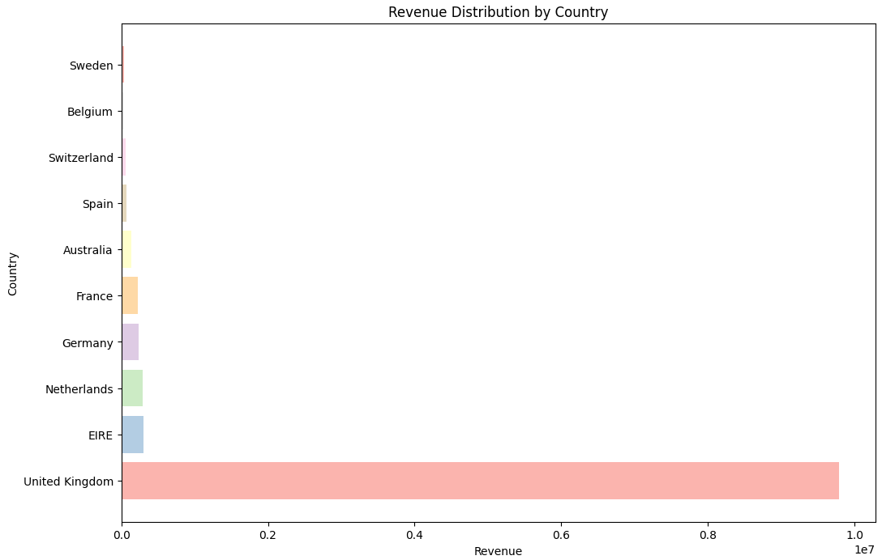
Revenue Distribution by Country
The UK dominates the revenue contribution in the bar chart analysis, which is expected since the company being analyzed is UK-based.
The presence of customers from various countries such as Germany, Spain, and Australia indicates the store's international reach and customer diversity.
Apart from the UK, significant revenue contributions come from countries like EIRE, Netherlands, Germany, and France.
These insights present valuable opportunities for market expansion in countries such as EIRE, Netherlands, Germany, and France.
Expanding into these countries will allow the company to access new customer bases and drive further growth in revenue.

Slide 8
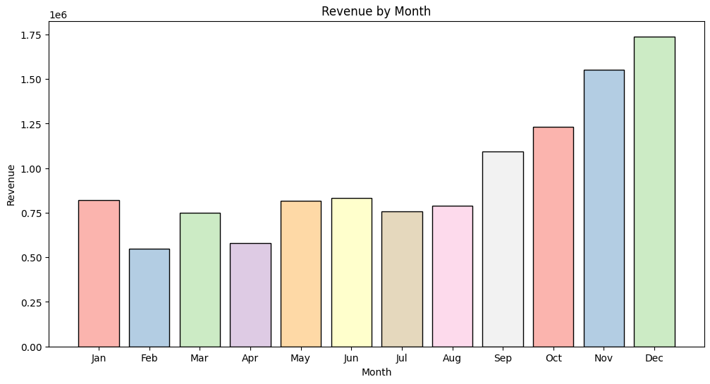
Revenue by Month
The chart reveals a distinct seasonal pattern in the company's revenue.
Revenue consistently increases from September onwards, peaking in December.
February represents the lowest point in revenue, suggesting a post-holiday lull in consumer spending.
December stands out as the month with the highest revenue, likely due to the holiday shopping season.
By aligning marketing efforts, promotional campaigns, and inventory management strategies to cater to the peak demand in December, the company can maximize its revenue potential and achieve positive business outcomes.

Slide 9
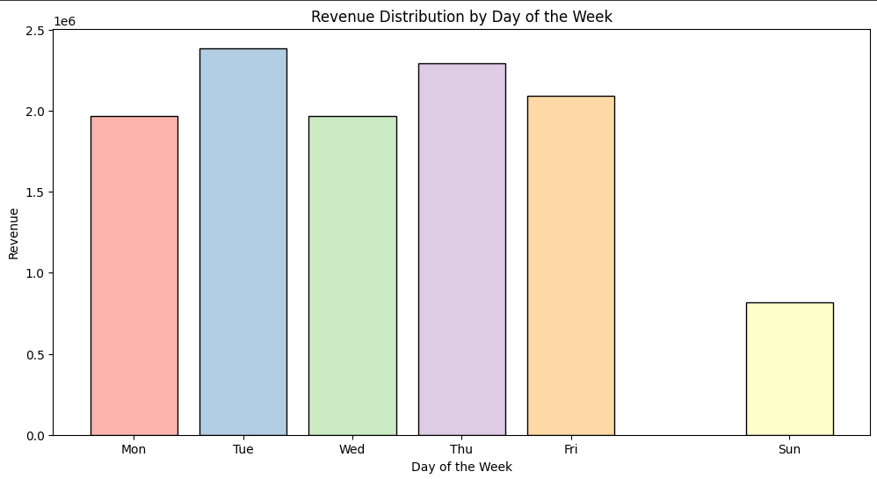
Revenue Distribution by Day of the Week
Tuesday emerges as the most profitable day, generating close to 2.5 million units in revenue.
Sunday records the lowest revenue, with approximately 1 million units.
No transactions are recorded on Saturdays, indicating non-operational status.
Revenue distribution across the remaining weekdays is relatively uniform.
By identifying Tuesday as the most profitable day, the company can leverage this knowledge to optimize marketing efforts, run targeted promotions, or allocate resources strategically to maximize revenue on that particular day.

Slide 10
ML Model Implementation
Two different models were implemented for this project: K-Means Clustering
The models were trained on a combination of features such as day of the week, month, quantity purchased, unit price of each unit, etc.
Cross-validation was used to evaluate the performance of each model and ensure they were not overfitting the training data.
Hyperparameter tuning was also performed on each model to improve their accuracy and reduce errors.
The best performing model was selected based on its performance metrics and used for final clustering of the customers.
The implementation of multiple models allowed for comparison and selection of the best performing model, ensuring the best results possible.

Slide 11

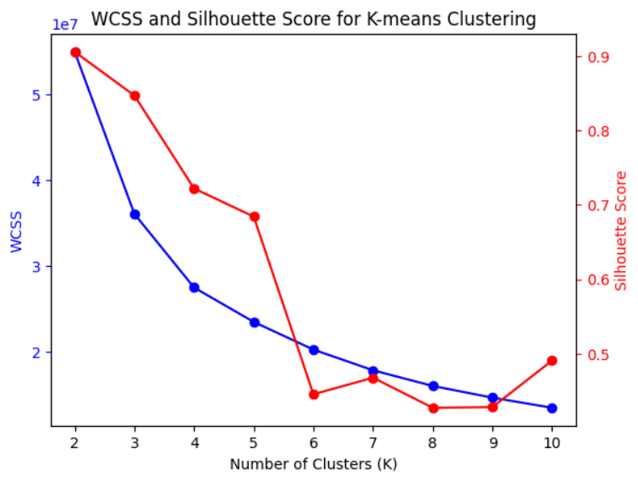
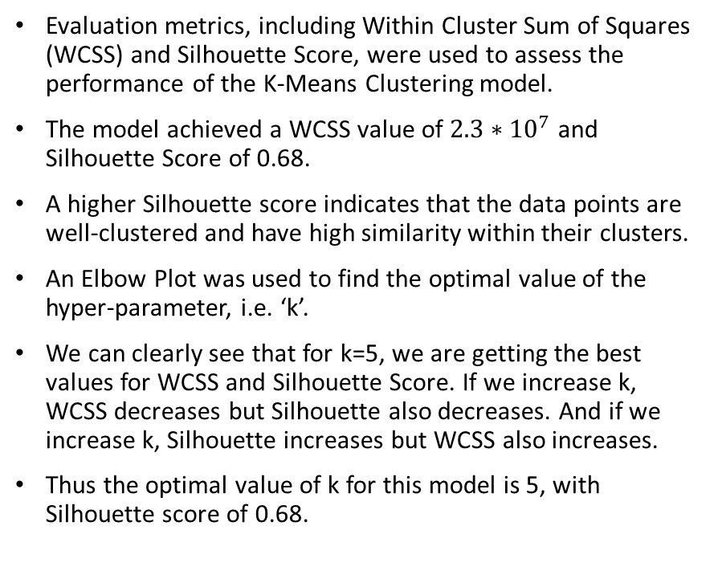
K-Means Clustering
Evaluation metrics, including Within Cluster Sum of Squares (WCSS) and Silhouette Score, were used to assess the performance of the K-Means Clustering model.
The model achieved a WCSS value of $2.3∗{10}^{7}$ and Silhouette Score of 0.68.
A higher Silhouette score indicates that the data points are well-clustered and have high similarity within their clusters.
An Elbow Plot was used to find the optimal value of the hyper-parameter, i.e. ‘k’.
We can clearly see that for k=5, we are getting the best values for WCSS and Silhouette Score. If we increase k, WCSS decreases but Silhouette also decreases. And if we increase k, Silhouette increases but WCSS also increases.
Thus the optimal value of k for this model is 5, with Silhouette score of 0.68.

Slide 12

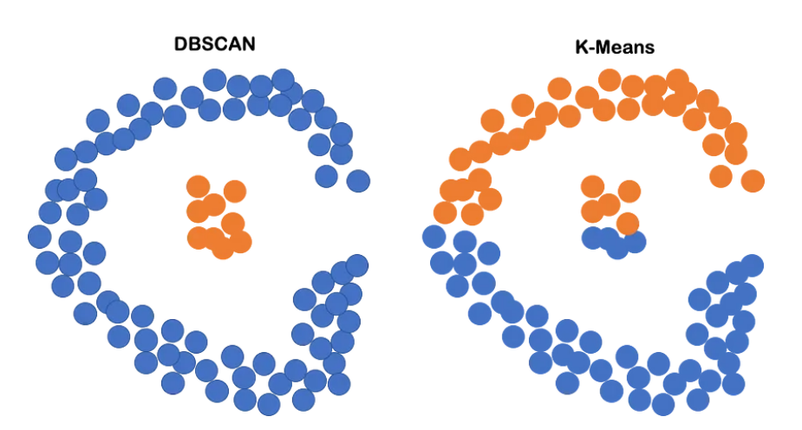
DBSCAN
The second model used was DBSCAN.
The benefit of DBSCAN over K-means clustering is that DBSCAN is capable of nested clustering, i.e. clustering one group which is present inside of another group. This is clear from the diagram attached.
For our dataset, DBSCAN achieved a Silhouette Score of 0.57 which after hyperparameter tuning, significantly increased to 0.78.
Thus the DBSCAN model outperformed the previous model, and will be used as the final model for clustering customers.

Slide 13
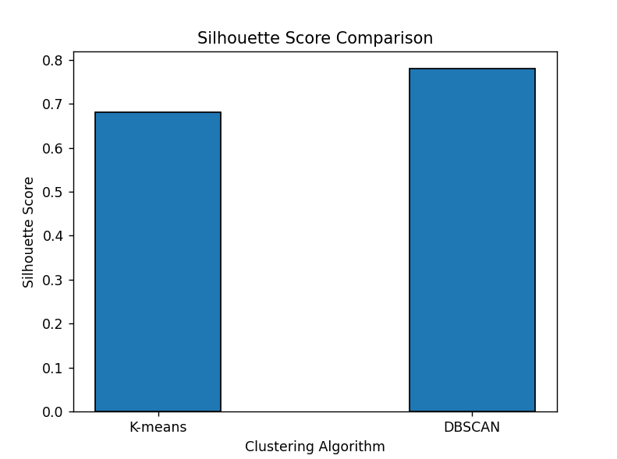
Comparison of the Models
The DBSCAN model demonstrated superior performance compared to the K-Means Clustering model, surpassing it by approximately 15% in terms of Silhouette Score.
With a Silhouette Score of 0.78, the DBSCAN model excelled in capturing intricate relationships within the dataset and effectively segmented the customers into distinct clusters.
The robustness of the DBSCAN model's results and its ability to handle complex data patterns make it the preferred choice for our final model selection.

Slide 14
Limitations
DBSCAN struggles with high-dimensional datasets due to the “curse of dimensionality.”
The algorithm may struggle to distinguish noise from legitimate clusters if the dataset contains a significant amount of noise.
DBSCAN assumes that clusters have similar densities and may struggle to handle datasets with clusters of varying densities.
The computational complexity of DBSCAN is relatively high, particularly as the dataset size increases.
DBSCAN assumes that clusters have a uniform density distribution and may struggle to accurately identify and separate clusters if the density of clusters varies significantly across the dataset.
It’s important to consider these limitations while applying DBSCAN to the dataset and explore alternative algorithms or techniques if necessary.

Slide 15
Recommendations
Capitalize on the revenue-generating potential of Tuesdays and December by strategically leveraging this information to maximize company profits.
Unlock new avenues of growth and expand market reach by venturing into countries such as Germany and France, tapping into untapped customer bases and driving further revenue growth.
Enhance customer satisfaction and optimize inventory management by analyzing the purchase quantity of popular items, enabling the business to align its offerings with customer expectations and efficiently manage stock levels.
While the DBSCAN model exhibited promising performance in this project, it is imperative to periodically evaluate its effectiveness and explore alternative models that are better suited to the specific business context and dataset characteristics.
Ensure the model's ongoing efficacy by regularly updating and retraining it with the latest available data, allowing it to adapt and maintain its performance over time.

Slide 16
Conclusion
We have successfully completed the Customer Segmentation project, leveraging insights on revenue generation patterns and identifying opportunities for growth.
The expansion into countries like Germany and France has unlocked new customer bases and contributed to driving further revenue growth for the company.
By analyzing popular items based on purchase quantity, we have improved customer satisfaction and optimized inventory management, aligning our offerings with customer expectations.
The implementation of the DBSCAN model has yielded positive results, but we acknowledge the importance of periodically reassessing its performance and exploring alternative models for continuous improvement.
Regularly updating and retraining the model with new data ensures its effectiveness over time, enabling us to adapt to evolving customer preferences and market dynamics.

Slide 17
THANK YOU!

